Slide 1
Computational Fluid Dynamics – ME 820 Computer Project #1
Daniel Franken

Slide 2
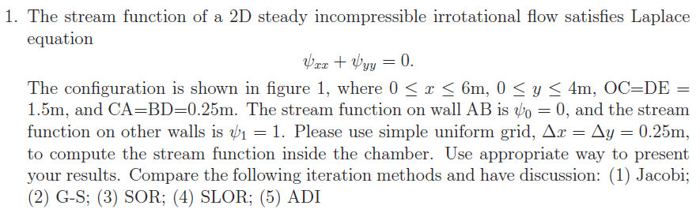
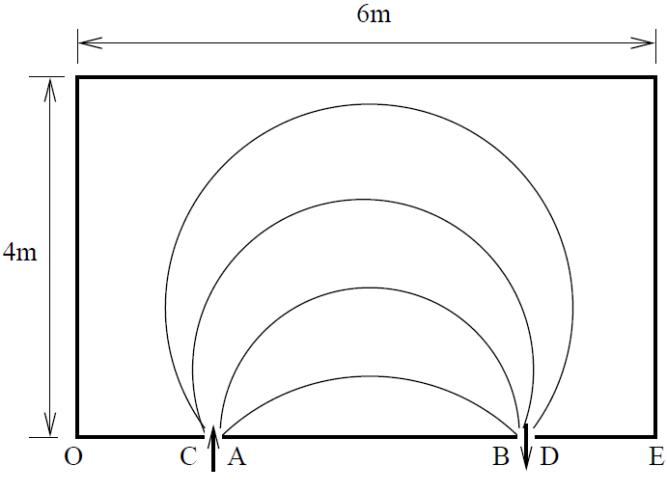
Problem Statement

Slide 3
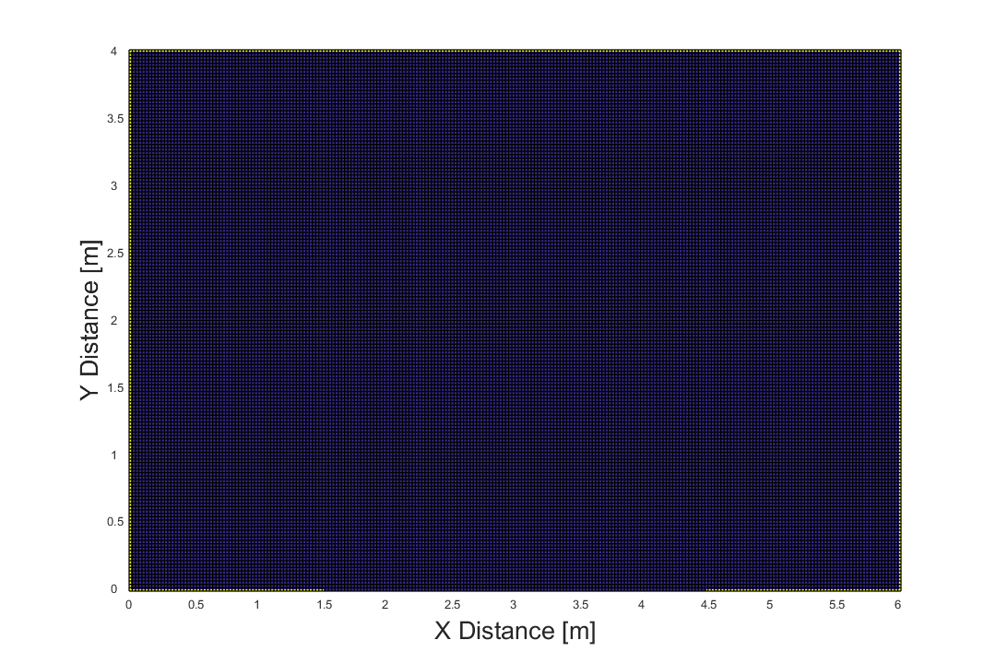
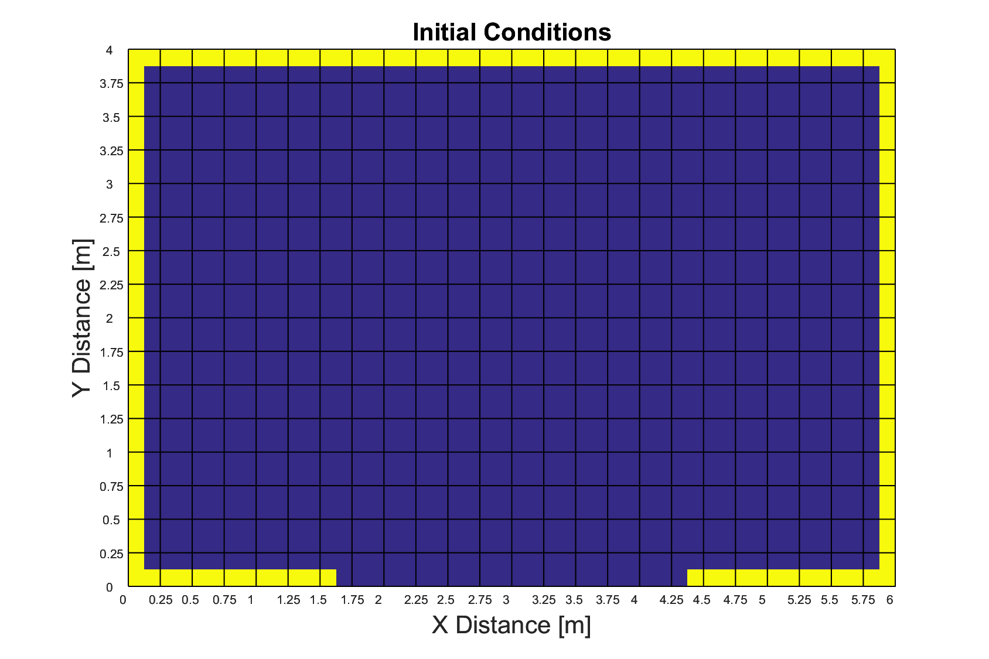
Initial Conditions
17 X 25 Mesh
161 X 241 Mesh

Slide 4
Jacobi

Slide 5
Jacobi

Slide 6
Gauss-Seidel

Slide 7
Successive Over Relaxation (SOR)
ω = 1.24

Slide 8
Successive Over Relaxation by Lines (SLOR)
ω = 1.24

Slide 9
Alternating Direction Implicit Method (ADI)
ω = 1.24

Slide 10
Error Comparison

Slide 11

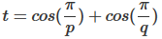
Error Comparison
[1]
ω = 1.24 for all cases
Optimized
ω_{Young}=1.7281
ω_{SOR}=1.725, ω_{SLOR}=1.2563, ω_{ADI}=1.295
[1] Young, D. (1954). Iterative methods for solving partial difference equations of elliptic type. College Park, Md.: Dept. of Mathematics, Univ. of Maryland.

Slide 12
Added Wall Condition

Slide 13
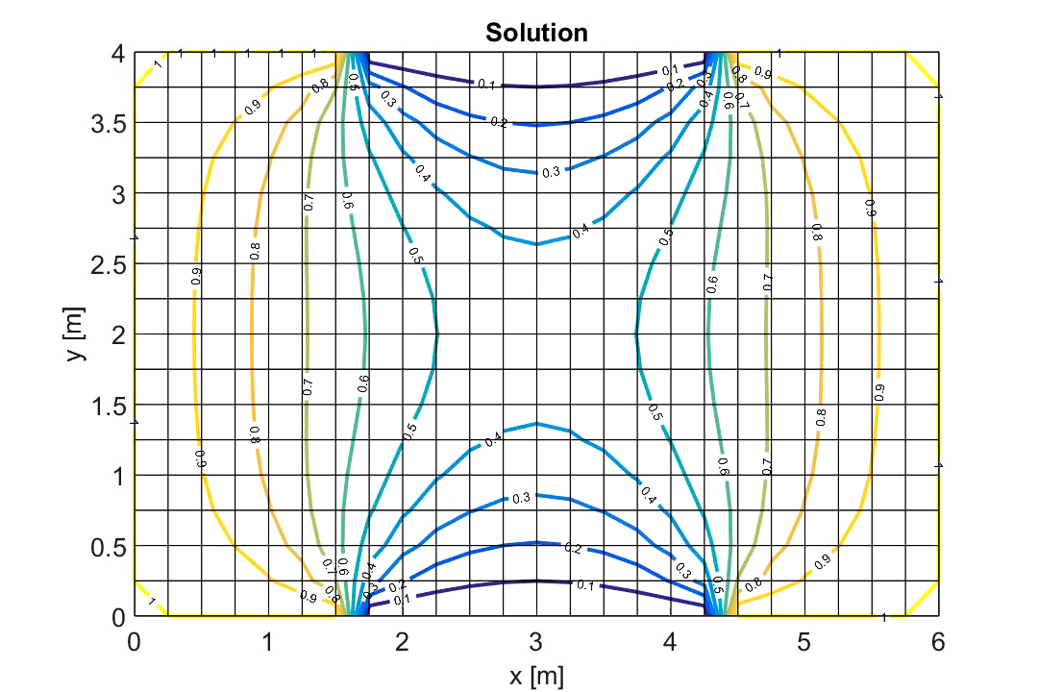
Added BC w/ Moving Wall With Slot

Slide 14
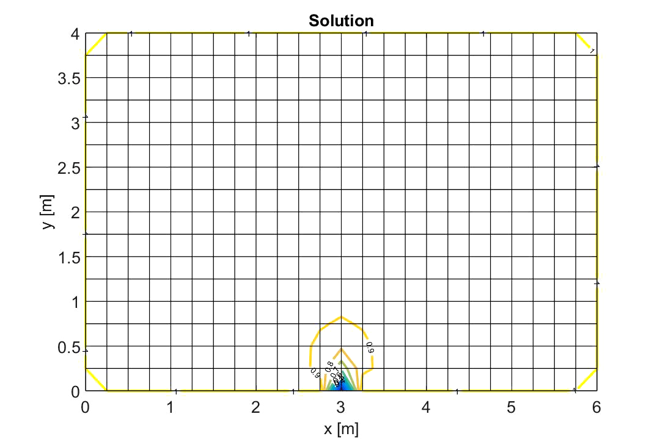
Moving Sink Term

Slide 15
Questions?

